Slide 1
Define the Project
A Module in Agile Fundamentals
This work is licensed under the
Creative Commons Attribution-ShareAlike 4.0 International License.
To view a copy of this license, visit http://creativecommons.org/licenses/by-sa/4.0/.
Notes:
In this module, we will talk about some of the core concepts that make Agile what it is. Rather than talk about software,
NEXT SLIDE
The Agile Core: Story Based Development & Incremental Business Value
User Stories, Use Cases and Scenarios
Looking at the Big Picture – Is up front planning OK?
“Good Enough” Software
Release Early and Often
The story:
Actors and use cases – sterile
Actors are causal, use cases state results of that causality
Use cases are explanatory, and rarely include business value
Storytellers, customers, and stories – comes alive
Roles represent
Stories are demanding, as well as explanatory
Stories tell you why, as well as what
Stories do NOT tell you HOW
Storytellers share experience and needs
The Big Picture – is it possible to know everything up front?
has anyone had a house built? Remodeling done?
Zeno’s Paradox of the Dichotomy
http://en.wikipedia.org/wiki/Zeno%27s_paradoxes#The_dichotomy_paradox
“That which is in locomotion must arrive at the half-way stage before it arrives at the goal.” ~Aristotle, Physics VI:9, 239b10
“The perfect is the enemy of the good.” ~Voltaire
Incremental, with constant review
Fail fast, learn quickly, adapt - PDCA
<number>
Define the Project

Slide 2

Establish a Shared Vision
Does the team know what the product is?
Do they have a clear, unambiguous goal?
Can the team articulate this vision?
Elevator statement
Magazine review
Press release
VC plan
Product box

Slide 3
Elevator Statement
Explains in 2 minutes what the product is
Who benefits from it?
What is the need?
How?
For people who knit
Jacob Wool provides 100% natural yarns.
They are easy to work with, colorfast, and comes in many weights.
Unlike Patons and Lion Brand yarn, Jacob Wool Yarn contains no synthetic
materials or man-made dyes, and is produced right here in Minnesota.

Slide 4
Product Box
Develop a box to ship the product
Write 3 to 4 key bullet points to sell it
You have 5 seconds in a store to get someone to buy
Typically, consumers read 2 bullet points before they put the box back on the shelf
Use color, logos, and develop a brand

Slide 5
HenchFund!
For Evil Henchmen
“Henchfund” provides a single, secure, no questions asked way to save for the average henchman's retirement.
Unlike normal retirement funds Henchfund distributes 50% of the savings of deceased henchmen to the other fund holders providing an incentive to avoid the James Bonds of the world

Slide 6
Roles & Goals
Notes:
The techniques discussed here are similar to traditional analysis techniques.
Agile does them quicker and at a higher level.
Agile uses index cards and post its and other fun office supplies to elicit and temporarily capture the data.
Understand just enough to make an estimate.
Understand just enough to get a fully formed picture of the solution, but not every detail.
Low: 1min
High: 3min
<number>
Define the Project

Slide 7
Roles and Goals
Who am I?
What do I want to do?
How will you support my goals?
Importance
Managing Director
“I’d like to easily see the status of Customers’ invoices”
Provide online information regarding Customers’ accounts.
5
Administrative Assistant
“ I need to generate a lot more letters than I do today”
Provide an automated approach to letter generation.
2
Technology Manager
“ I want to easily support all users”
Provide a solution in a language I can support.
4
Sales
“ I want to be able to sign on more customers with confidence.
Provide a system that can accommodate additional customers with the quality service.
3
Customer
“ I need to be confident that DC knows the status of each of my debtors’ invoices”
Provide a way to reflect invoice status by Debtor.
1
Notes:
Understand the differences between users of the same role.
Admin asst.
Sales. Manager, Sales folks.
Is Customer a role we should track?
Low: 3min
High: 6min
<number>
Define the Project

Slide 8
Roles and Goals
Who am I?
What do I want to do?
How will you support my goals?
Importance
Evil Henchman
Save for my retirement
Provide a secure anonymous way to save funds for my retirement
1
Henchfund manager
Invest hench funds in a diverse portfolio to make a massive bonus
Provide details of the current content and value of the hench fund so investing decisions can be made
2
Notes:
Understand the differences between users of the same role.
Admin asst.
Sales. Manager, Sales folks.
Is Customer a role we should track?
Low: 3min
High: 6min
<number>
Define the Project

Slide 9
Personas
Notes:
Low: 1min
High: 3min
<number>
Define the Project

Slide 10
What is a Persona?
Archetype / representation / profile
Description of end users
Reference document
Notes:
How many of you have heard of, worked with, created personae before?
You are not a user!
Create personas to bring the users to life
Fictional name, not Customer 1, but Ryan Green
Personas are about behavior patterns – they are not job descriptions
They act as a frame of reference throughout the Inception and development. “How would Ron feel about this?”
Use pictures to help the team see the personas as real people
Original bullets:
An archetype, representation or profile of our end-users
A description of our end-users that includes:
An overview of their role and their goals
Details of key characteristics
A name and a photo that give a human touch
A reference document to focus future discussion and debate
Low: 2min
High: 5min
<number>
Define the Project

Slide 11

Attributes of a Persona
Biographic
Technographic
Demographic
Knowledge and experience
Psychographic
Goals, needs, desires, attitudes, motivations
Notes:
Biographic
The personal story of their life. Where they grew up, where they went to school, marital status
Demographic
Vital statistics. Age? How long have they worked there? # of people in that role?
Low: 1min
High: 3min
<number>
Define the Project

Slide 12
How to develop personas
Identify roles and goals
Distribute behaviorally
distinct traits
Assign attributes
Personas
Notes:
For the administrative staff, how many different behaviors do you think we have with 20 folks?
Low: 2min
High: 5min
Define the Project

Slide 13
Collecting Stories
Notes:
Stories are the unit of work that gets measured, tracked, signed off.
Let’s talk about …………
Techniques for writing stories
Techniques for planning with stories
First the template
---------------------------------------------------------------------------------------------------------
While we talked about Stories in an earlier module on The Agile Core, we didn’t talk much about the process and the practices. Since Stories are one of the key tools in an Agile project, we’re going to talk a bit about some of the techniques that will help you in writing stories and working with them as part of the planning process.
Let’s start by reviewing the template for a user story.
<number>
Define the Project

Slide 14
User Stories
Three C’s
Card
Conversation
Confirmation
As a Librarian, I want to be able to search for books by publication year so that I can produce a chronological index
Notes:
Ron Jeffries – ‘Extreme Programming Installed’
Aspects of user stories
[CLICK]
Card – index card or virtual
Repository of information that is the requirements
Placeholder for [CLICK]
Conversation
Not enough info in the card
Has all the parts – Role, Goal, Value
What would the search results look like?
What are the search criteria?
Have the conversation when ready to do the work
Conversations with business, developers, testers
Document enough to do the work
[CLICK]
Confirmation
How we know the story is ‘done’
Acceptance criteria
“I will know this is complete when…..”
Story level acceptance criteria
---------------------------------------------------------------------------------------------------------------------------
You might say that User Stories are the “currency” of Agile Software Development. They are the central elements that identify what we’re doing and why we’re doing it.
Let’s consider the key aspects of User Stories.
First, there’s the Three C’s. [CLICK]
The first C is the Card, or story. Whether you are working in a physical world, and using index cards, or you are working in an electronic world like Mingle, and using virtual cards, this artifact serves two purposes: first, it is the repository of the information that is the story and is about the story; second, it is a placeholder for a future [CLICK]
Conversation. If you examine the story we have here, it is pretty obvious that there is not enough information here to know precisely what to build. It does follow the template, of course – the role is Librarian, the Goal is to have the capability to search books by publication year, and the value is so that a chronological index can be produced. But what would the search results look like? What would I do with them?
In order to clarify these questions, we would wait until we were ready to start development on our story, and then we’d have the Conversation. In the conversation we would dig into the details, figure out enough for the developers and testers to do their work, and document just enough of that information to enable us to do the work.
The third C is Confirmation. This is the combination of Acceptance Criteria and the actual testing to confirm that the goals and value of the story have been satisfied.
Without all three C’s, the story is not effective as a tool to guide the development of the software.
<number>
Define the Project

Slide 15
User Stories
Three C’s
INVEST
Card
I
Independent
N
Negotiable
Conversation
V
Valuable
Confirmation
E
Estimatable
S
Small
T
Testable
As a Librarian, I want to be able to search for books by publication year so that I can produce a chronological index
Notes:
Guidelines for writing good stories
Independent
Sales amount, sales percent, discount amount, discount percent
May want to split it – too big to fit into an iteration
Reports example. Or business rule applied to different products.
Write each as if they were the first story
Negotiable
Not a contract of what the software must implement
Conversations bring out details
Negotiate implementation, design
Get external links example.
Valuable
Valuable to the business, user, customer
This is the ‘So that’ part of the template
Everyone on the team should be able to articulate the value of the story
Estimatable
Clear and complete enough for the developers to estimate
If split as above, estimate the whole work for each.
Once foundation is complete, re-estimate the later stories
Small
Mike Cohn said it well:
“Like Goldilocks in search of a comfortable bed, some stories can be too big, some can be too small, and some can be just right. Story size does matter because if stories are too large or too small you cannot use them in planning.”
Must be completed in an Iteration.
Testable
Mike Cohn again:
“Stories must be written so as to be testable. Successfully passing its tests proves that a story has been successfully developed. If the story cannot be tested, how can the developers know when they have finished coding?”
----------------------------------------------------------------------------------------------------------
Next we have one of the key acronyms that helps us write and judge effective user stories: INVEST. This is one that you’ll want to learn, because you’ll find yourself using it all the time.
[CLICK] The I stands for Independent. As a valuable goal, we strive to ensure that each of our user stories is independent. That means that we try to write them in such a fashion that they can be estimated and implemented independently of other user stories. We’ll get into this in more detail later, because it’s such an important point. For now, let me give you an example: when working on a business intelligence project, a team wrote a story that included four measures in its Goal: sales amount, sales percent, discount amount, discount percent. At the first writing, this seemed to be a reasonable story. After a bit of understanding and experience was gained, it became clear that it made sense to break this into four stories. Of course, the development team’s first reaction was that they had to pick one story to do first, so that they could do all the underlying work with that story. That would mean that the other stories would be dependent on that story getting done first. This is a mistake that many teams make when working with stories. When we get further down in the INVEST acronym, we’ll talk more about why this is so.
[CLICK] The N stands for Negotiable. This means that stories are not written contracts or requirements that the software must implement. Story cards are short descriptions of functionality, the details of which are to be negotiated in a conversation between the customer and the development team. Because story cards are reminders to have a conversation rather than fully detailed requirements themselves, they do not need to include all relevant details. This allows room in the discussion, at the time the story is implemented, to negotiate some of the details and the implementation.
[CLICK] The V stands for Valuable. This means that it is valuable to purchasers or users of the software, and also means that it is valuable to the business. As we discussed earlier, when reviewing the story template, being able to articulate the value of a story is essential. Without being able to articulate and understand the value, it is reasonable to question why we’re writing or implementing a story.
[CLICK] The E stands for Estimatable. That means that a story must be at a fine enough granularity, with enough clarity and detail, that the team is able to estimate it. Let’s go back to the story we introduced when talking about the “I” for Independent. When this story first came up – the story including the four measures – the team estimated it relatively high, because of the combination of foundational work – adding to and modifying the database, for instance – and the detail required for each of the measures. Upon reflection, as noted earlier, the team opted to separate this story into four separate stories, one for each measure. The problem was with that Independence. They said “if we implement any one of these stories first, it will be an eight – any other story will be a two after that – so which story should we do first?” The answer was to estimate them all independently, as if they were going to do all of that foundational work on all of them. Of course, we know that that would not be the case, but it enables the team to maintain that independence. When it came time to choose among the stories for implementation, that left the Product Owner with the freedom to choose any of them, based on current priorities. Once the first story was done, the team could then re-estimate the remaining stories with the understanding that the foundational work had been done and the remaining stories would be easier to implement.
[CLICK] The S stands for Small. Mike Cohn said it well: “Like Goldilocks in search of a comfortable bed, some stories can be too big, some can be too small, and some can be just right. Story size does matter because if stories are too large or too small you cannot use them in planning.” Further, Mike says “The ultimate determination of whether a story is appropriately sized is based on the team, its capabilities, and the technologies in use.” When we work with Agile teams, one of the guidelines we use is whether a story can be completed in an Iteration.
[CLICK] And finally, the T stands for Testable. Let’s quote Mike Cohn again: “Stories must be written so as to be testable. Successfully passing its tests proves that a story has been successfully developed. If the story cannot be tested, how can the developers know when they have finished coding?”
Remember the acronym – INVEST – Independent, Negotiable, Valuable, Estimatable, Small, and Testable.
<number>
Define the Project

Slide 16
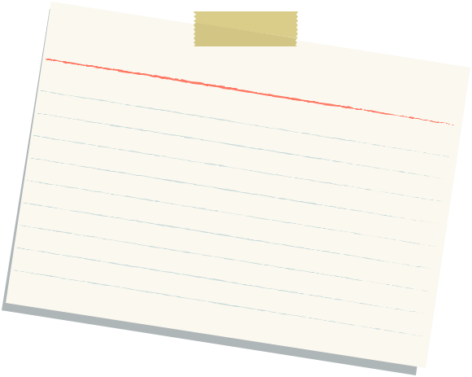
Parts of a Story
Unique #:
Title:
Description:
As a
I want to
So that
Assumptions:
Estimate:

Slide 17
Parts of a Story
I will know this is complete when…….

Slide 18
User Story Template
Role: As a …
Goal: I want/need …
Value: So that …
From User Stories Applied: For Agile Software Development
by Mike Cohn
Notes:
From Mike Cohn’s book “User Stories Applied”.
Role
Identified during inception
Identifier for a common set of tasks or permissions
[CLICK]
Goal
What the user wants to do, not what the system is supposed to do.
The feature
[CLICK]
Value
Why are we building this functionality?
Should tie back to a business objective
--------------------------------------------------------------------------------------------------------------------
The story template we use comes from Mike Cohn’s book “User Stories Applied”. It has three parts:
The Role: this is an identifier for a common set of tasks or permissions.
The Goal: this is what is to be accomplished. This is stated in terms of what the person or role wants to accomplish, not what the system is supposed to do.
The Value: this is one of the most important parts. Without understanding what this story means to the person in the role or the organization – the business – we are left asking the question “why are we doing this?” The value statement may be the hardest part of user stories. Expressing the role and the goal are generally pretty clear, although we’ve seen some challenges there too. The value, though, is hard. People are inclined to say things like “because that’s my job!” or “so that we can do our business.”
We’ll come back to this template repeatedly as we go, because it’s such a key part of what we do and how we do it.
<number>
Define the Project

Slide 19
User Story Template
Role: As an Evil Henchman
Goal: I need a secure Henchfund account
Value: So that my identity can not be traced by James Bond
From User Stories Applied: For Agile Software Development
by Mike Cohn
Notes:
From Mike Cohn’s book “User Stories Applied”.
Role
Identified during inception
Identifier for a common set of tasks or permissions
[CLICK]
Goal
What the user wants to do, not what the system is supposed to do.
The feature
[CLICK]
Value
Why are we building this functionality?
Should tie back to a business objective
--------------------------------------------------------------------------------------------------------------------
The story template we use comes from Mike Cohn’s book “User Stories Applied”. It has three parts:
The Role: this is an identifier for a common set of tasks or permissions.
The Goal: this is what is to be accomplished. This is stated in terms of what the person or role wants to accomplish, not what the system is supposed to do.
The Value: this is one of the most important parts. Without understanding what this story means to the person in the role or the organization – the business – we are left asking the question “why are we doing this?” The value statement may be the hardest part of user stories. Expressing the role and the goal are generally pretty clear, although we’ve seen some challenges there too. The value, though, is hard. People are inclined to say things like “because that’s my job!” or “so that we can do our business.”
We’ll come back to this template repeatedly as we go, because it’s such a key part of what we do and how we do it.
<number>
Define the Project

Slide 20
Acceptance Criteria
Notes:
Stories are the unit of work that gets measured, tracked, signed off.
Let’s talk about …………
Techniques for writing stories
Techniques for planning with stories
First the template
---------------------------------------------------------------------------------------------------------
While we talked about Stories in an earlier module on The Agile Core, we didn’t talk much about the process and the practices. Since Stories are one of the key tools in an Agile project, we’re going to talk a bit about some of the techniques that will help you in writing stories and working with them as part of the planning process.
Let’s start by reviewing the template for a user story.
<number>
Define the Project

Slide 21
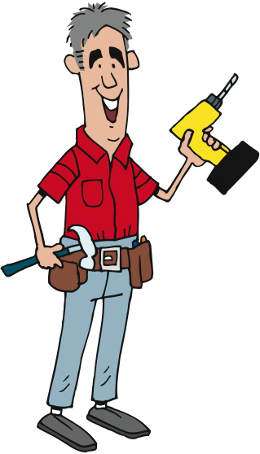
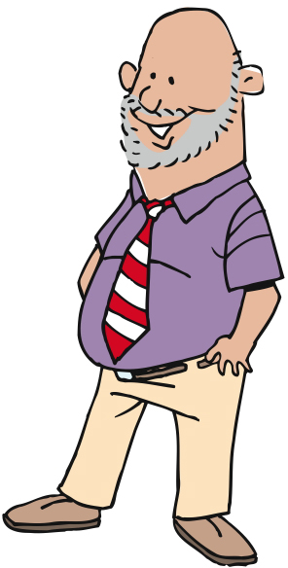
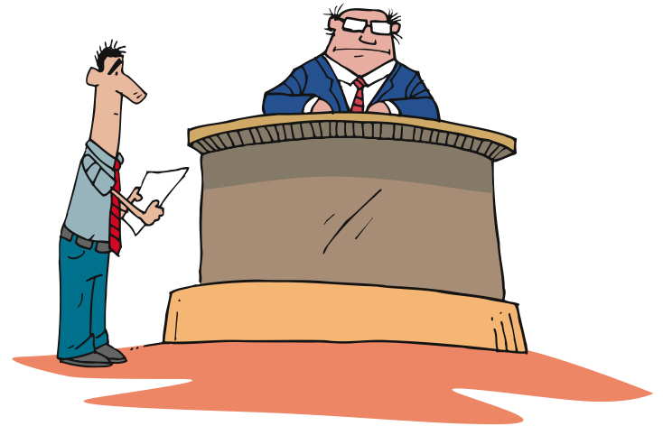
Done, done, done…
The code passed all my unit tests and integration tests, so I am done…
The code works as I expected it to, so I am done…
The code does what I need, and works as I expected it to, so it is done…

Slide 22
Iteration Acceptance Criteria
The Context: Given…
The Event: When…
The Outcomes: Then…
Given that the user is not logged in
When the user clicks on the Shopping Cart link
Then they should be required to log in
Reference: Dan North’s Blog @ http://dannorth.net/introducing-bdd
Notes:
Inception level vs. Iteration level criteria
Inception - I’ll know this is complete when …… [CLICK]
Iteration Level…
Given – preconditions to the story. State of the system, object, role [CLICK]
When – the action[CLICK]
Then – the result
Gives context for estimating
Security is a good example.
I’ll know this is complete when each role logs in and they receive the proper access or not.
vs. each role spelled out in the Narrative as a separate Given, when then statement.
When each statement is fulfilled, the story is done
-------------------------------------------------------------------------------------------------------------------------------
Now that we have a story, we need to address that Testable attribute. We do this by defining the acceptance criteria. That is, we identify those criteria which, when met, allow us to assert that the story has been completely and successfully implemented.
While there are many ways to phrase or write the acceptance criteria, we prefer the scenario template devised by Dan North and Chris Matts, and first documented in an article by Dan published in Better Software magazine in March of 2006. You can read it on Dan’s blog at dannorth.net/introducing-bdd as you’ll see on the slide.
The template has three clauses, like the user story template. In this case, they specify…
[CLICK] the initial context, using the keyword “given”. This clause identifies the pre-existing conditions that must exist before we can execute or experience…
[CLICK] the event, or action, which is specified using the “when” keyword. Finally, we specify…
[CLICK] the outcomes or expectations using the “then” keyword. Here’s an example…
[CLICK] First, the context – the user must not be logged in. Note that the Given – the context – is NOT part of the test, but rather is the set-up. That is, in this case we assume that the ability to log in and the permissions associated with that logging in have been dealt with elsewhere. This particular scenario is focused on verifying that a user is required to log in before being able to click on the Shopping Cart link. It is not focusing on whether or not it is possible to log in.
Once the context is set up, then we have the specific event, or behaviour, that is executed. This is the action in the test. In this case, the action is to click on the Shopping Cart link.
Finally, the scenario specifies one or more outcomes. In this case, the user should be required to log in. This might more properly be written “a login form is presented to the user” since that is measurable.
It’s important to note that there may be multiple parts to the Context – the Given clause – and to the Outcomes – the Then clause – but there will normally be only a single part to the Event – the When clause.
The acceptance criteria should be written so that they are executable, preferably in code.
We’ll talk about when to add the acceptance criteria to a story later in this module.
Define the Project

Slide 23
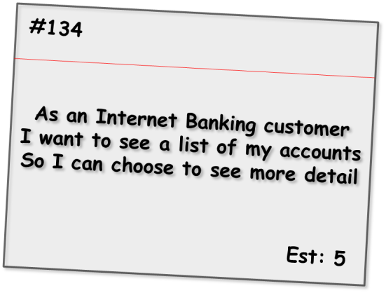
Iteration Acceptance Criteria
Given the customer has one transaction account and one credit account
When they have completed logging in
Then the screen should show the names and numbers of the two accounts sorted in account number order
Given the customer has just one transaction account
When they have completed logging in
Then the screen should show the name and number of the account
Alternate path
Given the customer has no accounts
When they have completed logging in
Then the screen should show a message stating that no accounts are available
Alternate path
Given the customer has more than 20 accounts
When they have completed logging in
Then the screen should show the first 20 accounts (in account number order) only
Bad path
Given the customer has some accounts
When they have completed logging in
And the system cannot retrieve the account details
Then the screen should show an error message with associated code and details to contact for support
Notes:
This format is iteration level acceptance criteria vs Inception level.
Shows positive, alternate and bad paths.
Talk through each one.
Low: 3min
High: 6min
-----------------------------------------------------------------------
Here we see a set of criteria for an Internet Banking story covering a range of positive, alternate and bad paths through the requirement. As is expected, the positive paths map directly to the requirements as stated and assume everything is working as expected.
The alternate path criteria describe non-standard ways to meet the desired outcome, which although may not be considered within the narrative of the story, are still reasonable to assume as usage patterns for the system.
Bad path criteria describe situations in which the outcome cannot be achieved, in this case how the system would behave in the case of an internal error.
<number>
Define the Project

Slide 24
Questions?
Notes:
What we’ve done……
Seen how best practices address traditional project challenges
Learned the process
Met the team
<number>
Define the Project

